Slide 1
Hotel Booking Demand
By: Thomas Simon

Slide 2
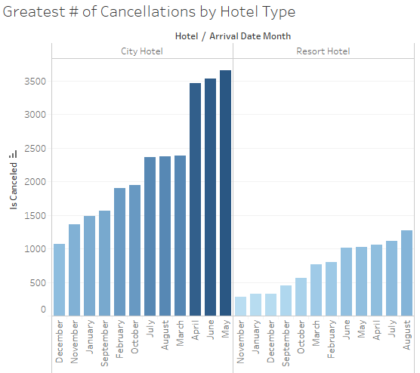
City Hotel Cancellations are more problematic than Resort Hotels
Key Insight
City Hotel Cancellations in April, June, and May are the biggest problem driving overall cancellations. Before even looking into remedying cancellations at resort hotels, we should focus on city hotels since even the best performing month, December, is equivalent to Resort Hotel’s highest cancellation month.

Slide 3
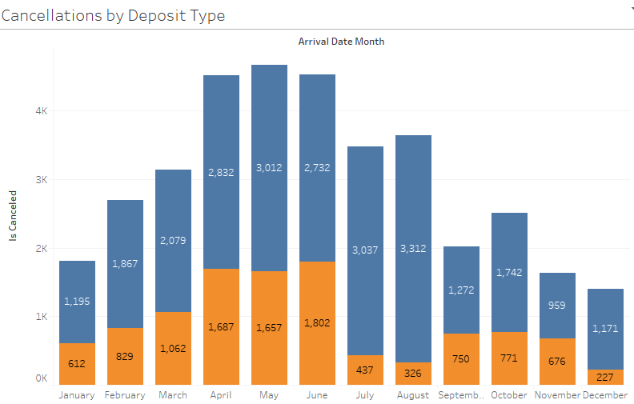

Up to 1/2 of the money is saved in Non-refundable cancellations
Key Insight
If we’d like to mitigate risk further from year- round cancellations, we should increase non-refund offerings, especially in months July and August.

Slide 4
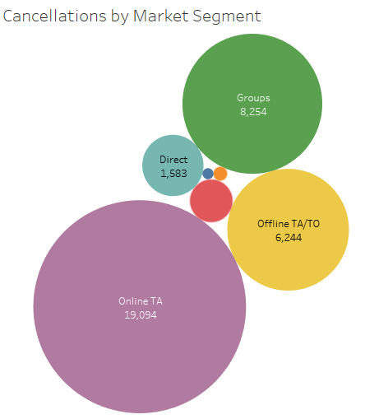
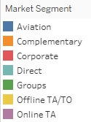
Cancellations are happening most often via Online Travel Agents
Key Insight
Online TA cancellations are almost 3x greater than Offline TA/TO and more than 2x larger than Groups. This is likely a result of family vacations during the summer months booked online; we should consider focusing on increasing corporate sales because that’ll likely result in fewer cancellations.

Slide 5
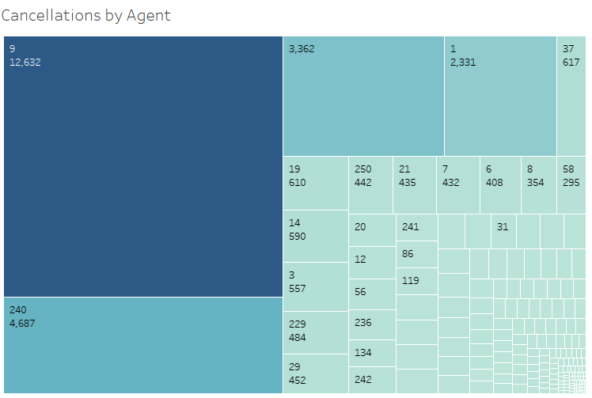
Agent 9 is garnering almost 300% more cancellations than the 2nd worst performer in relation to cancellations
Key Insight
What’s interesting is that the 3rd worst performer shows that there are 3,362 cancellations through a non-specified agent. We should look further into what’s enabling this figure. Is this direct sales, which may be altogether bypassing an agent?

Slide 6
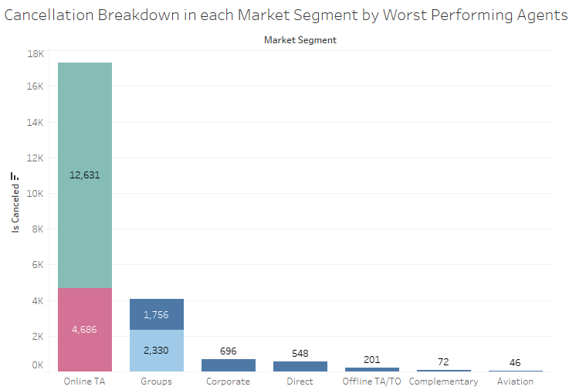
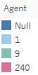
Agent 9 leads majority of the cancellations in our largest market segment, Online TA
Key Insight
We should focus on investigating Agents 9 and 240 since Online TA is our largest market for cancellations and they’re the two largest contributing agents.

Slide 7
Recommendations
Focus on City Hotel Cancellations, especially during Months April, May, and June
Consider increasing non-refund offerings to mitigate loss in revenue
Increase corporate sales to mitigate seemingly inevitable cancellations from Online Travel Agents during the summer months
Investigate Agents 9 and 240 since they’re the 2 largest contributors to cancellations

